Slide 1
GAME OF MACHINE
-HOUSE INCEPTEZ

Slide 2
Team 7 Machine Failure Prediction Kaleel Ahamed Muthu Lakshmi Raja Sekar Sudalai Mani

Slide 3
OBJECTIVE:
To find the failure criteria of machinery from the given Dataset

Slide 4
INTRODUCTION
We have three set of Data’s
Sample.csv
Train.csv
Test.csv
We have started with train dataset , here we first took Date Field, moved to humidity, temperature , operator and finally concluded with failure rate based on all these fields

Slide 5
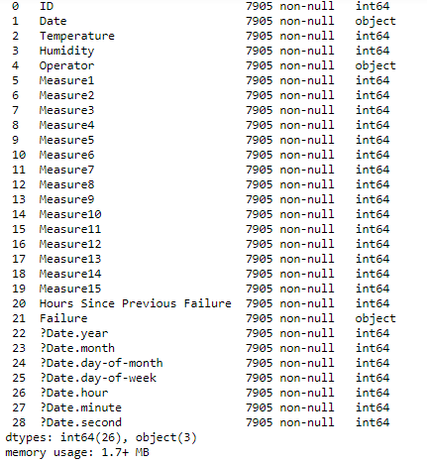
Our Data Set Info

Slide 6


Slide 7
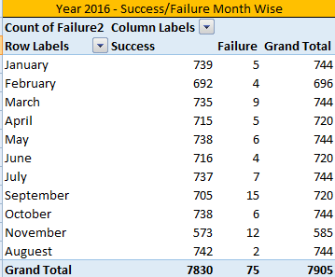

Slide 8
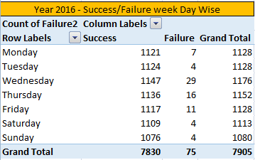

Slide 9
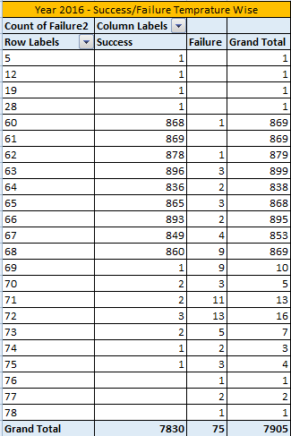

Slide 10
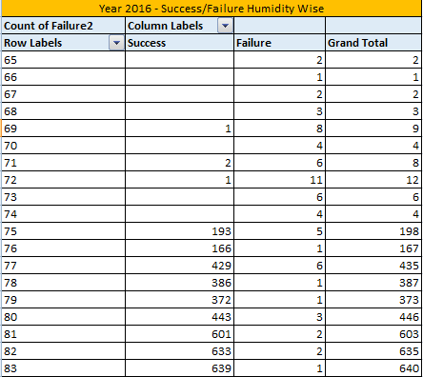

Slide 11
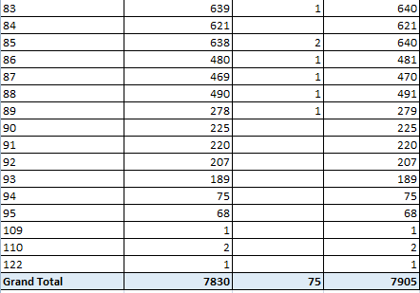

Slide 12
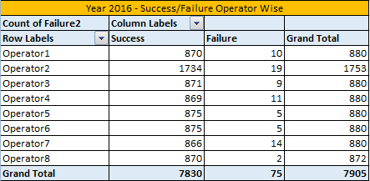

Slide 13
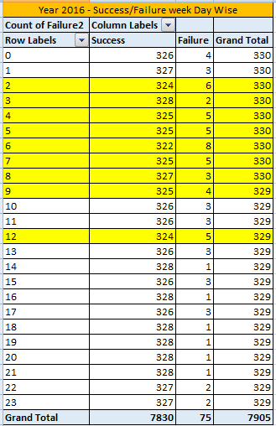

Slide 14
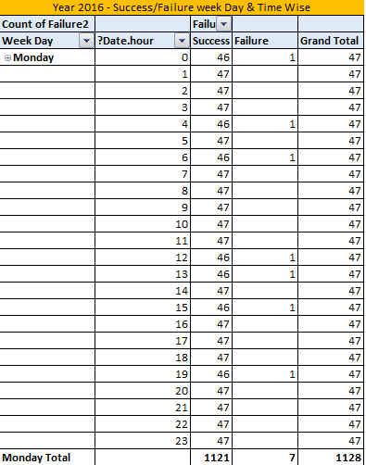

Slide 15
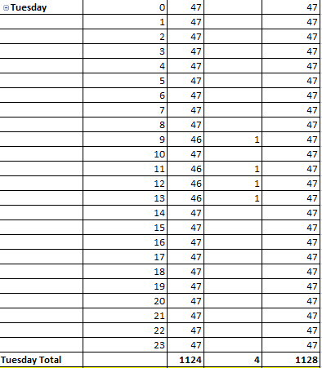

Slide 16
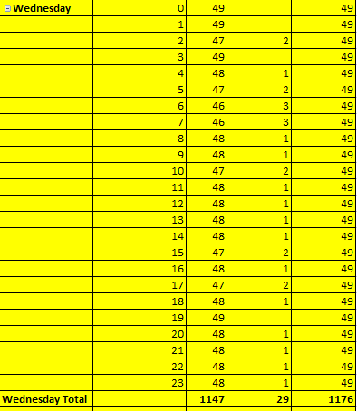

Slide 17
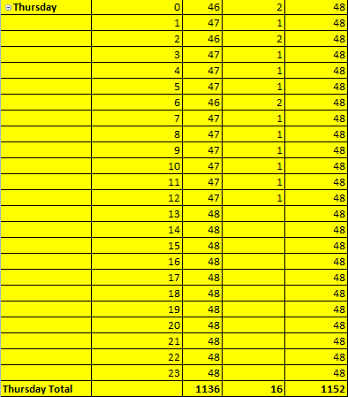

Slide 18
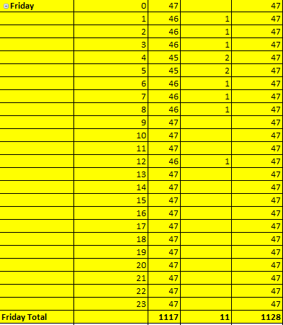

Slide 19
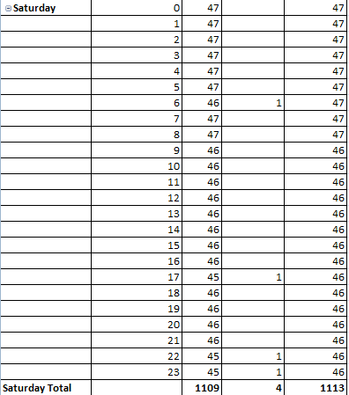

Slide 20
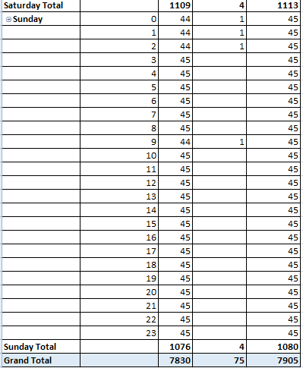

Slide 21
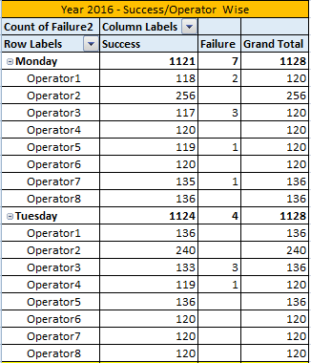

Slide 22
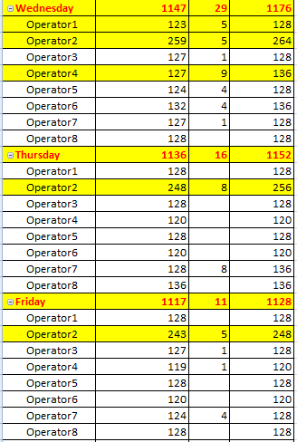

Slide 23
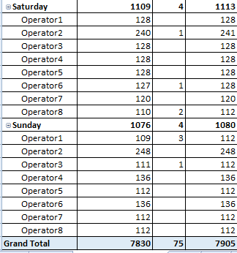

Slide 24
CONCLUSION
The Failure Rate occurs Maximum during
Night Shift from 2 PM to 9 AM
Wednesday
Operator 2

Slide 25
Thank You!!!!

